Slide 1
Fiverr - TBD
Market place
Project Definition
Team Members:
Emanuel Ben Hamo, Rotem Carmon, Vova Eygel

Slide 2
Highlights
Product Name: Fiverr - TBD
Product Short Description:
Marketplace for web design and development service
Users:
Guest users, Sellers, Buyers, Admin
Key features:
Offer web design & development services, purchase web services, chat between buyers and sellers,
Show sellers reviews & description
Guest mode:
Guest can browse all services offered in the marketplace and look at specific seller details, information & reviews

Slide 3
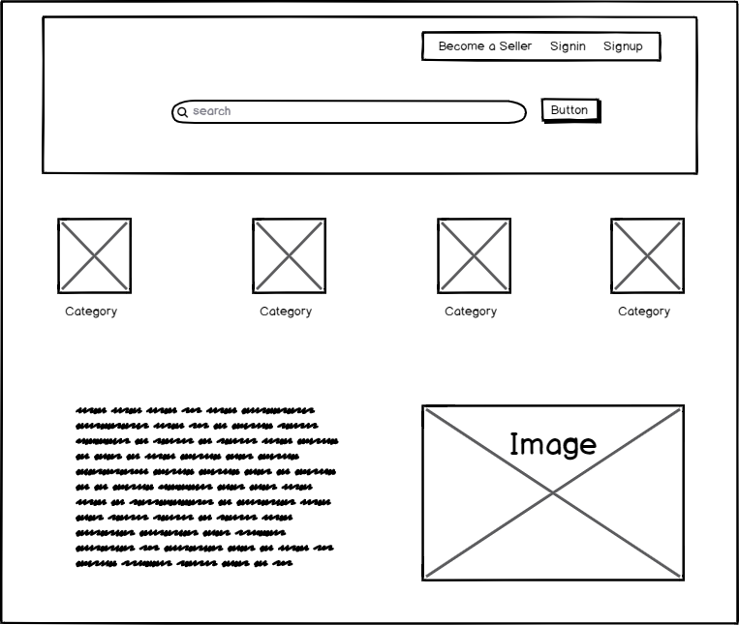
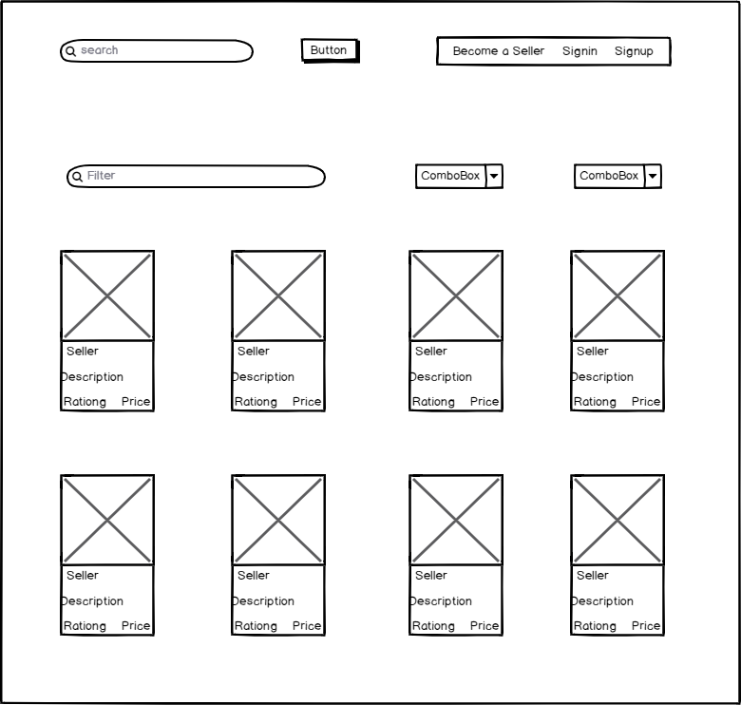
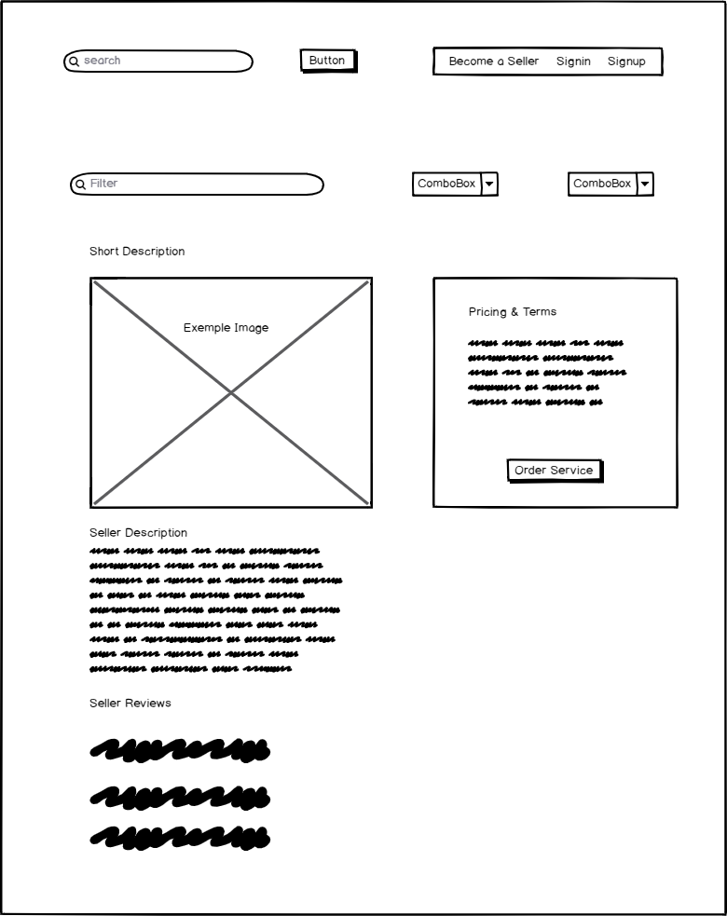
Main Pages
Home page
View the categories of the professional services offered by sellers.
Category list
View all services in a selected category.
Service page
View the details of a selected service (gig).

Slide 4
Main Flows
Clicking a category item on the home screen – user is directed to the services page where the user can view services (product) offered in the selected category.
Clicking a service item on the category screen – user is directed to a single service (product) offered by a seller.
Home page
Categories page
Service (product) page

Slide 5
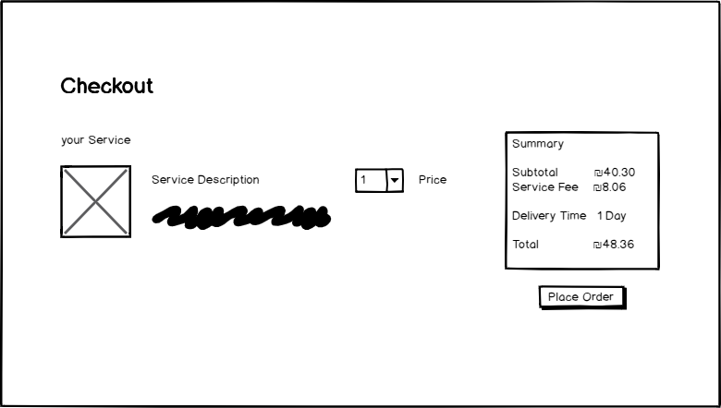
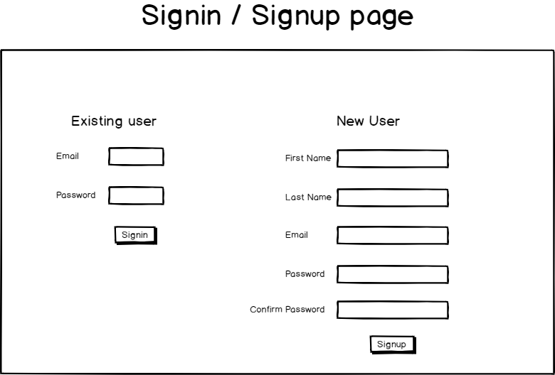
Main Flows
The user clicks the “order service” button, if he is signed in, the app will redirect to the checkout page.
If signed in
else
If the user is not signed in, the app will redirect to the login/signup page.

Slide 6
Main Pages UX

Slide 7
Home page
Top fold

Slide 8
Service (product) page
Top fold

Slide 11
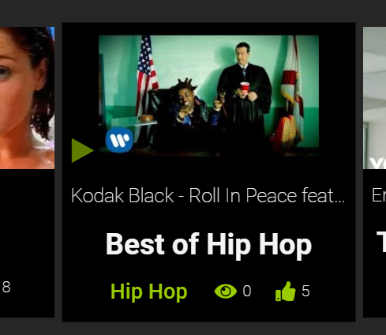
Main component – Music Station Preview
Pay while staying at the home page
Youtube thumbnail
Artist + Song name
Click anywhere to enter the station
Station name
likes
Genre / category
Currently listening count

Slide 12
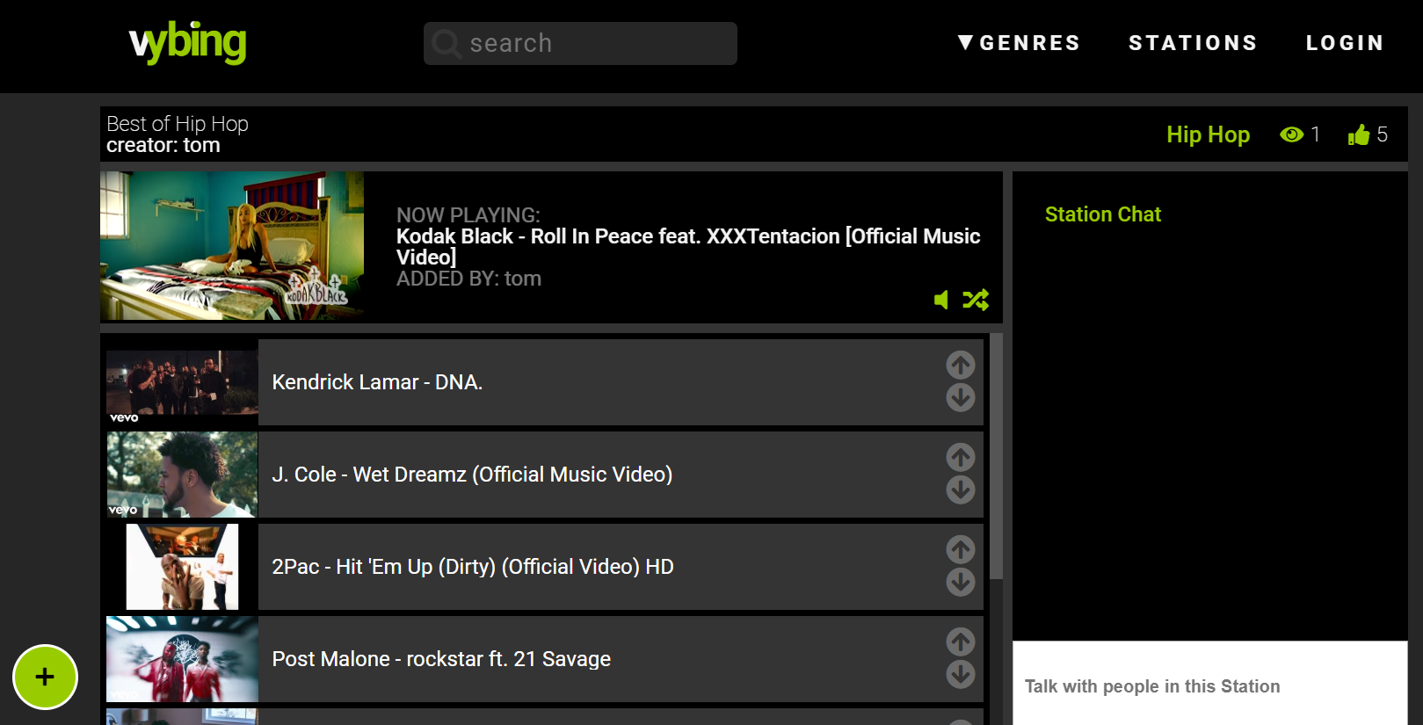
Station Page
Stations
Now playing
chat messages
Appear here
Dudu: amazing song
Duda : amazing dud
Rachel : not so sure about his music
Input for chat messages
Add songs
Artist + song name
Mode song up / down

Slide 13
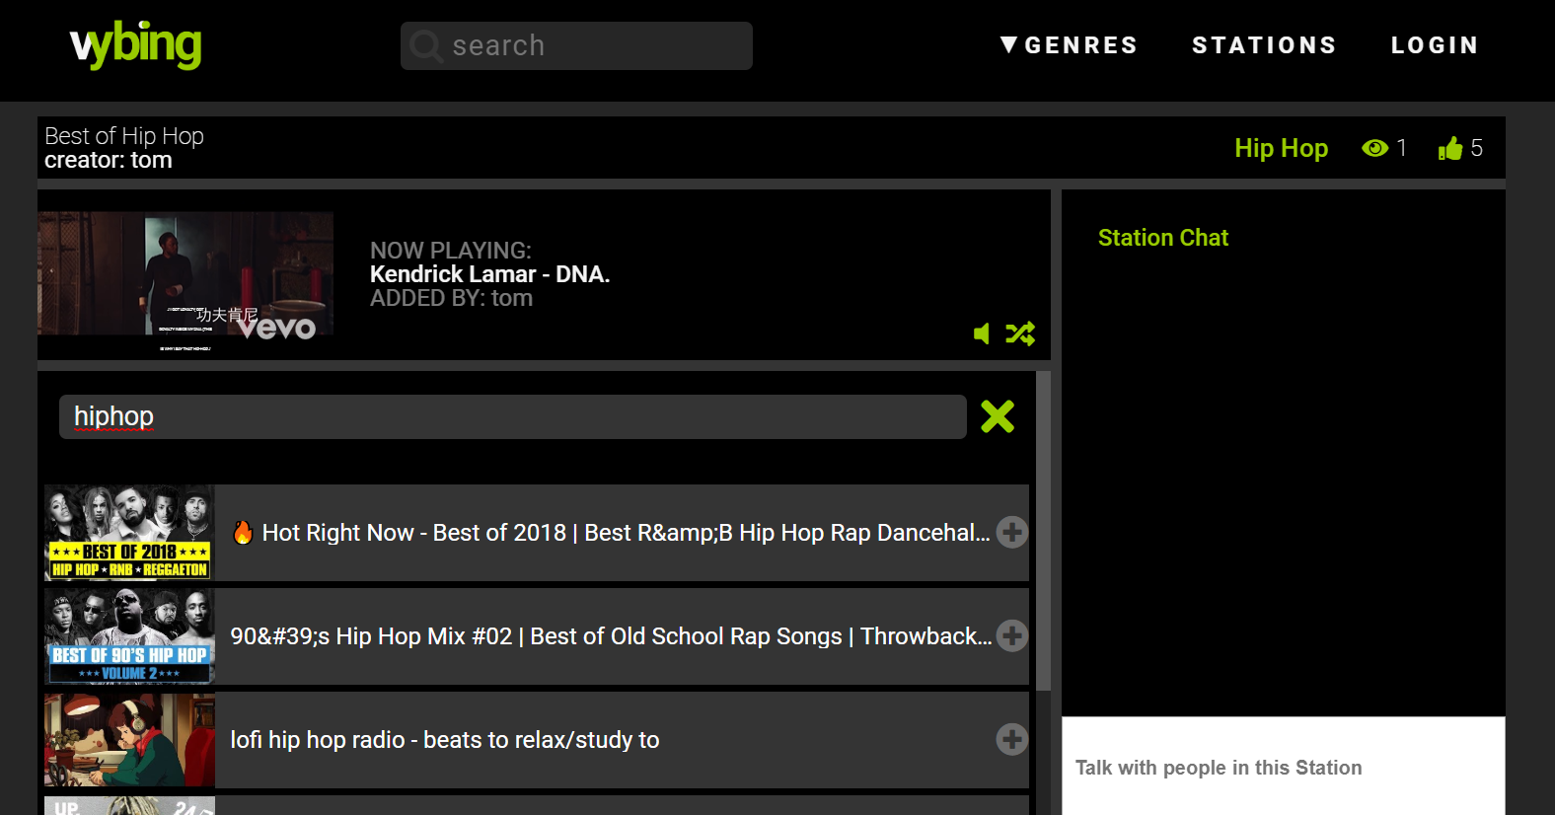
Station Page > Add Song
Stations
Close “add song”
Dudu: amazing song
Duda : amazing dud
Rachel : not so sure about his music
Search songs
Add to station

Slide 14
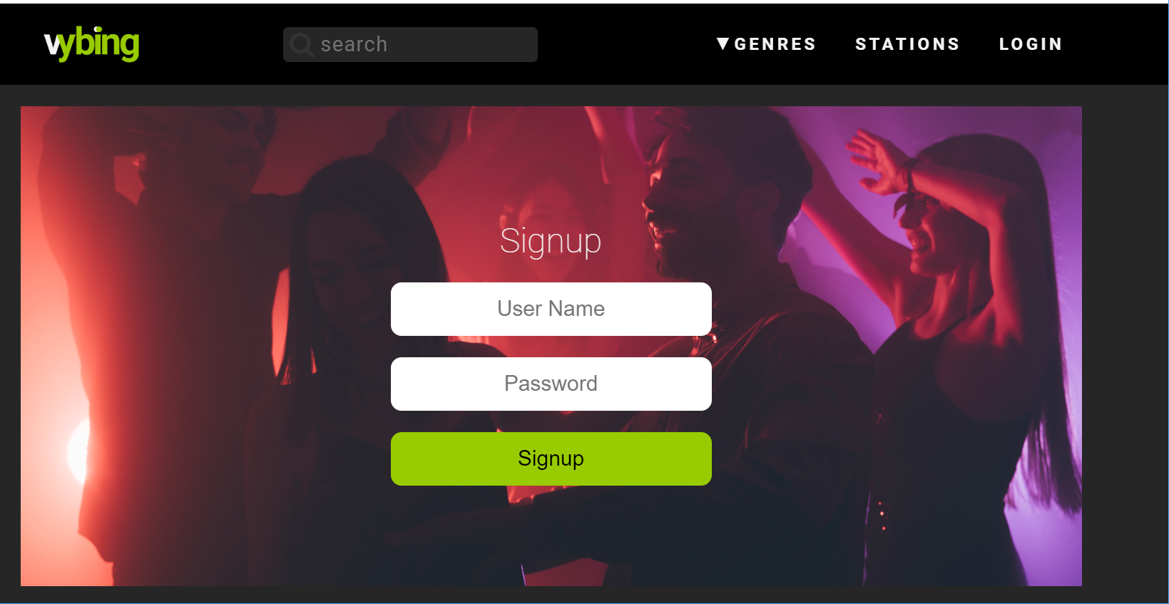
Login Page
Stations

Slide 15
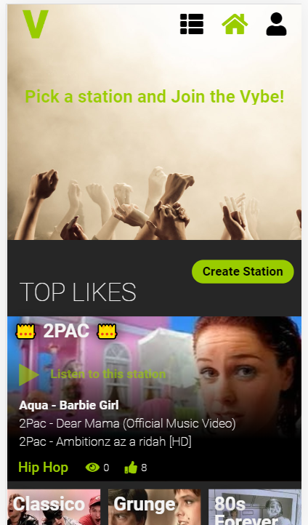
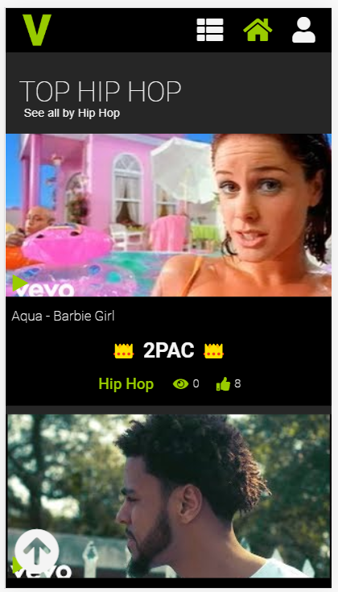
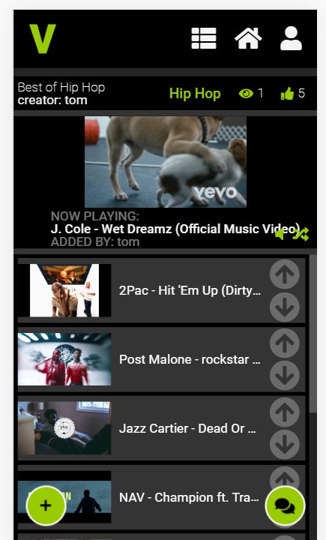
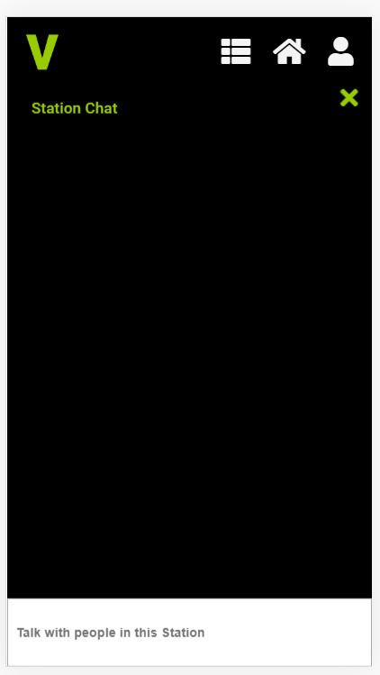
Main pages - mobile view

Slide 16
Socket Protocol
on
stationJoined (user)
stationLeft(user)
playlistUpdated (playlist – an array of songs)
activeSongChanged (songId, time)
newChatMsg (msg)
emit
joinStation (stationId)
leaveStation (stationId)
updatePlaylist(playlist)
changeActiveSong (songId, time)
sendMsg (msg)

Slide 17
Pages and Components

Slide 18
Pages
Page | Description | Routing
Homepage | Shows top rated stations and then stations per genre sorted by popularity | /
Stations | This page has query string parameter and shows specific stations, for example: /stations?genre=Hiphop Or: /stations?q=hip | /stations
StationDetails | Shows details about the station and the live playlist, this page uses the socket to keep all listeners on real time and to chat | /station/s101
StationEdit | Allow creating, updating (and deleting) a station including the playlist | /station/edit/:id?
UserDetails | User profile including created and liked stations | /user/u101
LoginSignupPage | Login / Signup | /signup

Slide 19
Components
Component | Props | Emits | Description
stationPreview | Station | liked | Preview of the station with a link to station page
stationList | Stations | Liked | List of stations
songSearch |  | Song | Allow the user to find a song and emit to parent
chatApp |  |  | Allow users to chat

Slide 20
Used Techs and APIs
Ajax and REST API
CRUDL for stations with axios and Node.js
Authentication
User/password and server session
Storage
Cloudinary to store users profile and station images
Database
Mongodb on Atlas cloud databases
Web Sockets
Multi room with a Socket per station
Youtube API
Add and play songs from Youtube based on user search
Share
Share to Facebook (if time permits)

Slide 21
Thanks

